Slide 1





Introduction To Python Programming

Slide 2

Hello!
I am Eslam Ahmed
I am a software engineer.
You can find me at jeksogsa@gmail.com

Slide 3

Hello!
I am Eman Ehab
I am a ML research engineer.
You can find me at emanehab.ieee@gmail.com

Slide 4
Introduction to Python programming Course Outline
Intro to Computer Science
Environment Setup (Anaconda)
Command Line
Conda & pip package managers
Jupyter Notebook
Input & Output
Variables
Data types
Numbers & Math
Boolean & Comparison and Logic
Strings
Lists
Tuples
Sets
Dictionaries
File Handling
If Conditions
For Loops
Built-in functions & Operators (zip, enumerate, range, …)
List Comprehensions
Functions
Lambda Expressions
Map, Filter, Reduce
Variables Scope
Modules & Packages

Slide 5
Introduction to Python programming Course Outline
Intro to Computer Science
Environment Setup (Anaconda)
Command Line
Conda & pip package managers
Jupyter Notebook
Input & Output
Variables
Data types
Numbers & Math
Boolean & Comparison and Logic
Strings
Lists
Tuples
Sets
Dictionaries
File Handling
If Conditions
For Loops
Built-in functions & Operators (zip, enumerate, range, …)
List Comprehensions
Functions
Lambda Expressions
Map, Filter, Reduce
Variables Scope
Modules & Packages

Slide 6
Intro to Computer Science
How Computers Work
Decimal & Binary numbering systems
How computer store Words (ASCII)
How computer store Images
How computer store Videos
How computer store Audio
How computer understand Mouse
How computer understand Keyboard
How computer understand Speaker & Microphone
How computer understand Monitor & Camera
Technology Tree
Why python

Slide 7
Intro to Computer Science
How Computers Work
Decimal & Binary numbering systems
How computer store Words (ASCII)
How computer store Images
How computer store Videos
How computer store Audio
How computer understand Mouse
How computer understand Keyboard
How computer understand Speaker & Microphone
How computer understand Monitor & Camera
Technology Tree
Why python

Slide 8
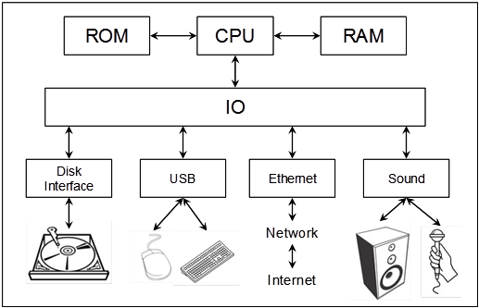



How Computers Work

Slide 9
Intro to Computer Science
How Computers Work
Decimal & Binary numbering systems
How computer store Words (ASCII)
How computer store Images
How computer store Videos
How computer store Audio
How computer understand Mouse
How computer understand Keyboard
How computer understand Speaker & Microphone
How computer understand Monitor & Camera
Technology Tree
Why python

Slide 10
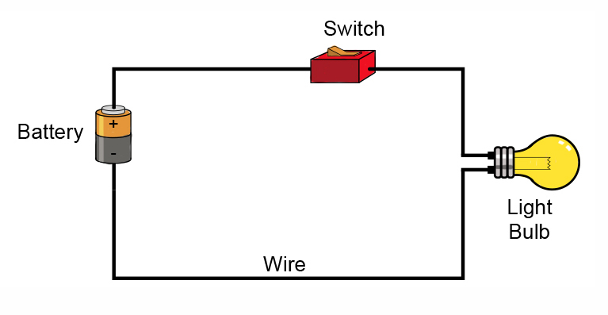
Decimal & Binary numbering systems

Slide 11
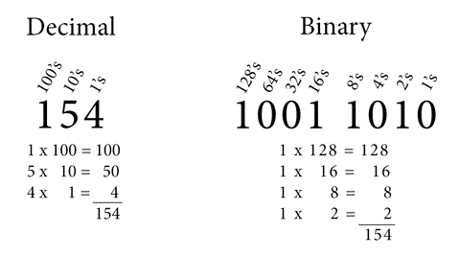
Decimal & Binary numbering systems

Slide 12
Intro to Computer Science
How Computers Work
Decimal & Binary numbering systems
How computer store Words (ASCII)
How computer store Images
How computer store Videos
How computer store Audio
How computer understand Mouse
How computer understand Keyboard
How computer understand Speaker & Microphone
How computer understand Monitor & Camera
Technology Tree
Why python

Slide 13
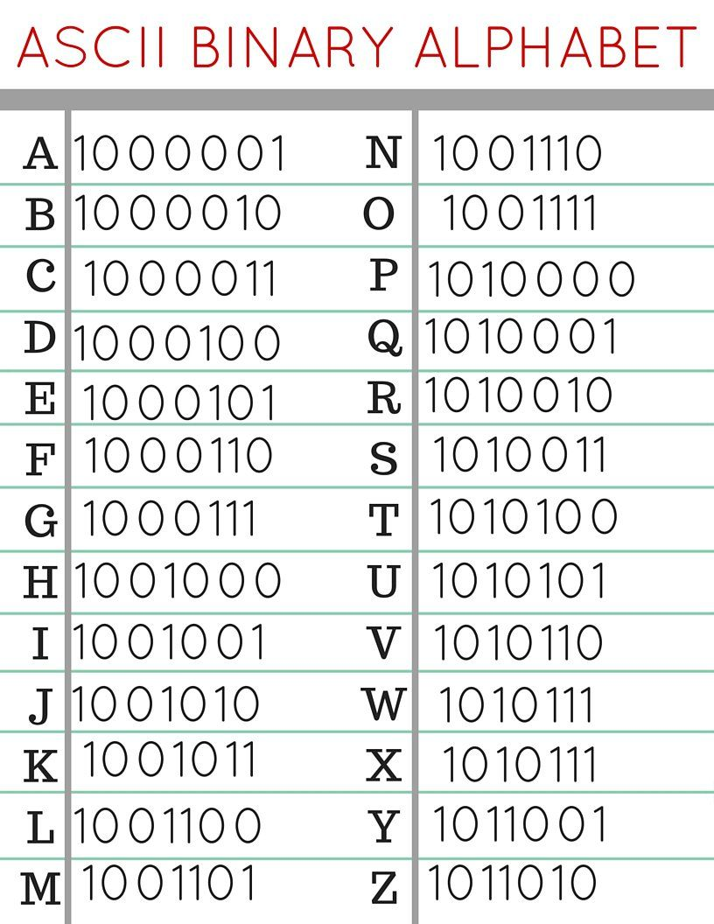
How computer store Words (ASCII)
Full Table
http://www.asciitable.com/

Slide 14
Intro to Computer Science
How Computers Work
Decimal & Binary numbering systems
How computer store Words (ASCII)
How computer store Images
How computer store Videos
How computer store Audio
How computer understand Mouse
How computer understand Keyboard
How computer understand Speaker & Microphone
How computer understand Monitor & Camera
Technology Tree
Why python

Slide 15
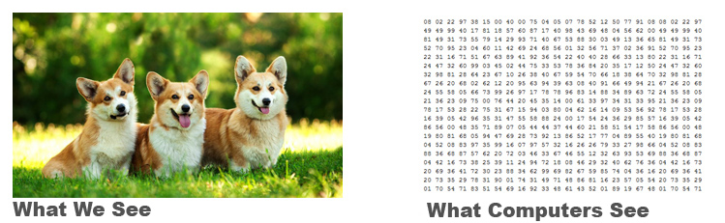
How computer store Images

Slide 16
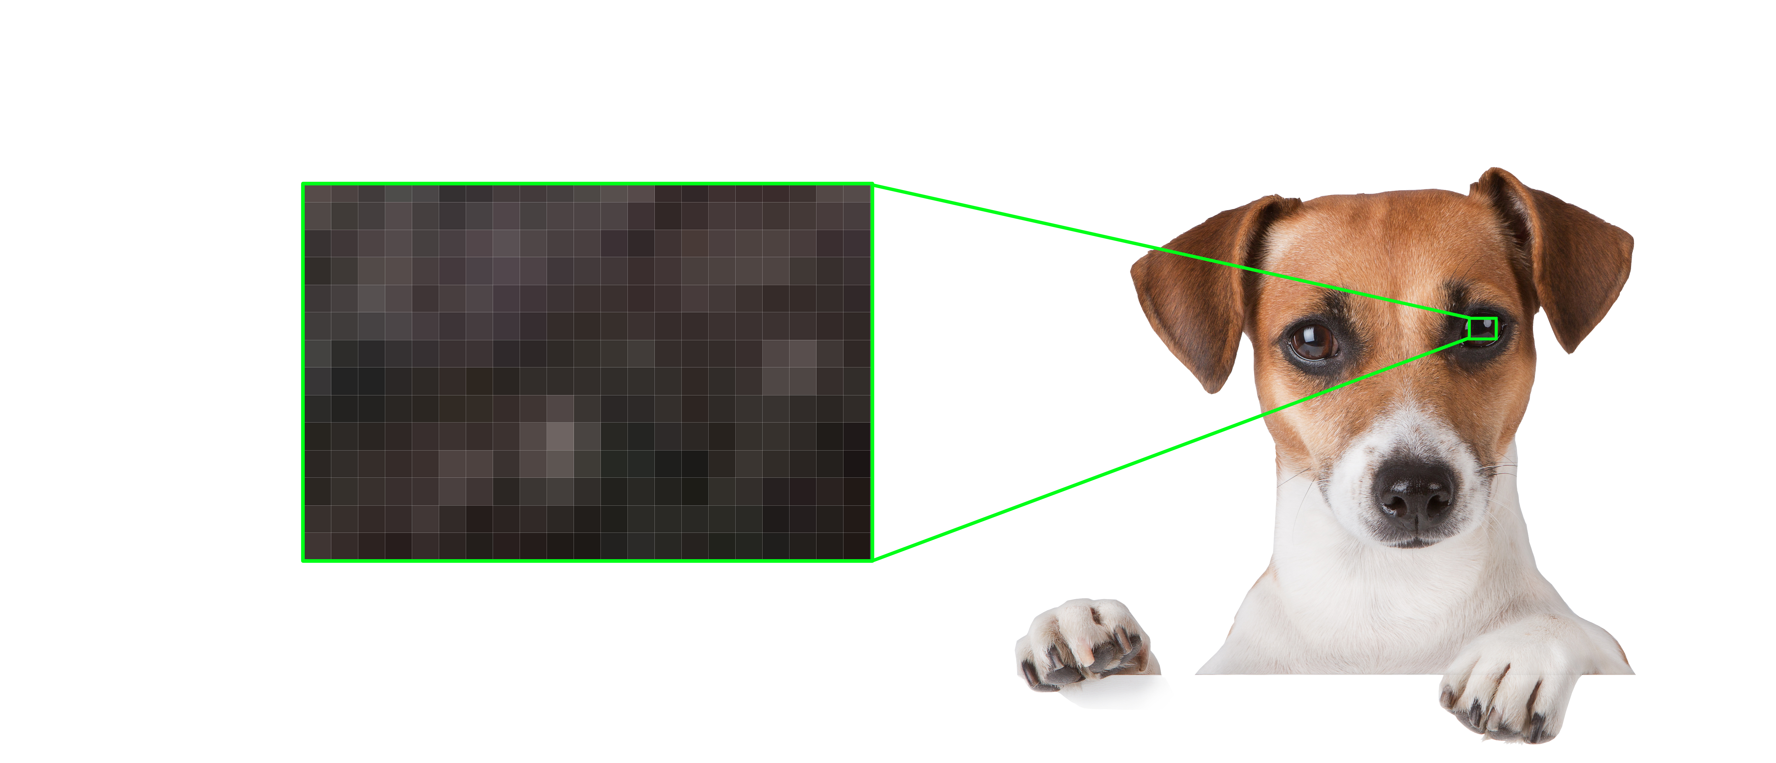
How computer store Images
Pixels
Every pixel is one color
Height
Width

Slide 17

How computer store Images
RGB Digital Images
We can generate any color by mixing
(red, green, blue) colors with different ratios.

Slide 18
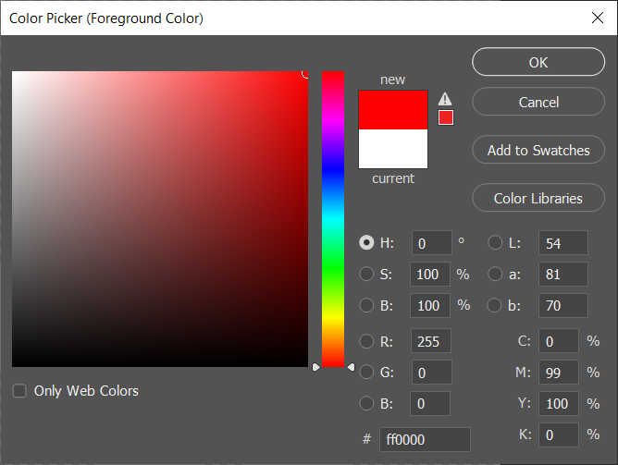
How computer store Images (Red)

Slide 19
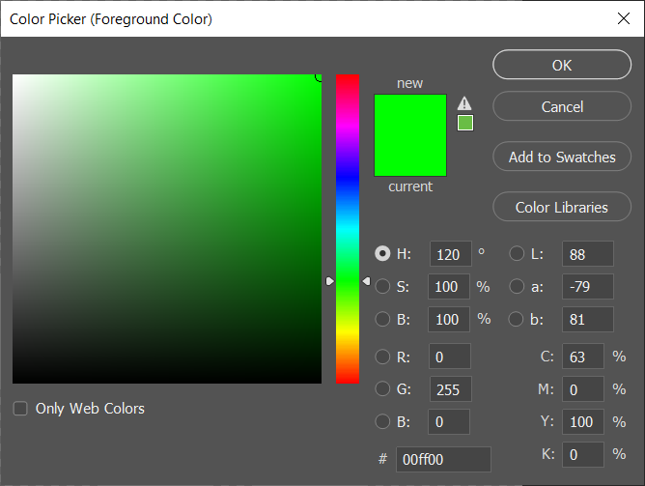
How computer store Images (Green)

Slide 20
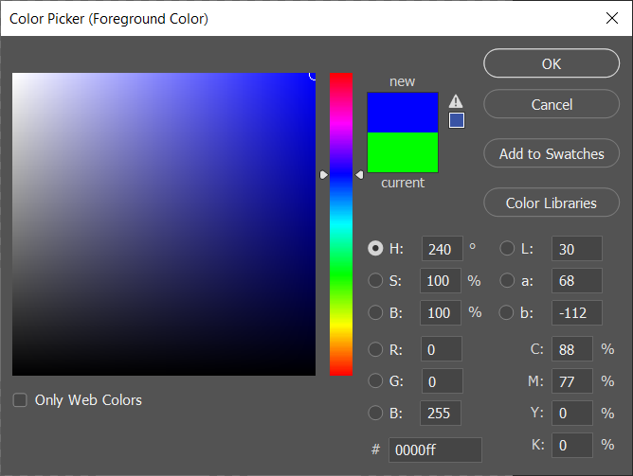
How computer store Images (Blue)

Slide 21
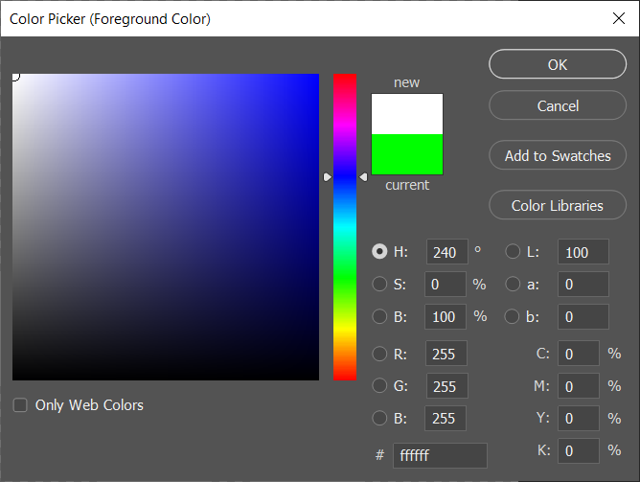
How computer store Images (White)

Slide 22

How computer store Images (Black)

Slide 23
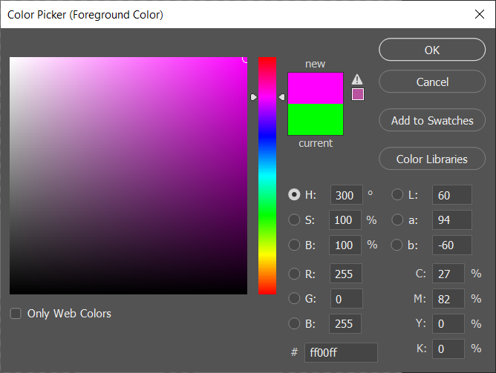
How computer store Images (Pink)

Slide 24
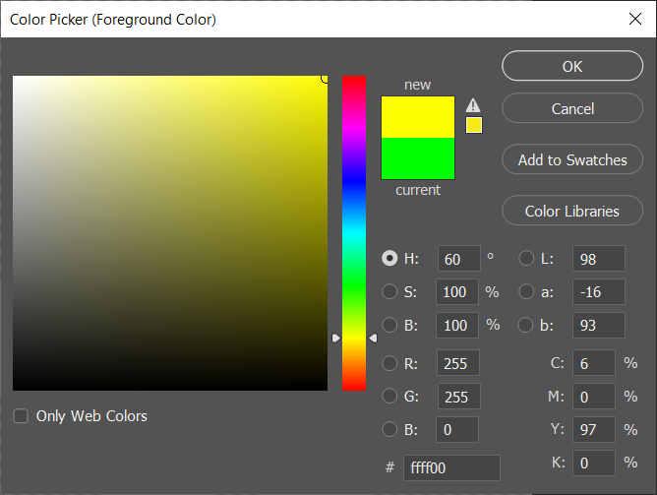
How computer store Images (Yellow)

Slide 25
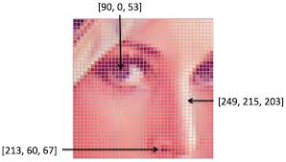
How computer store Images
Resolution: 100x100
Width : 100 pixels
Height: 100 pixels

Slide 26
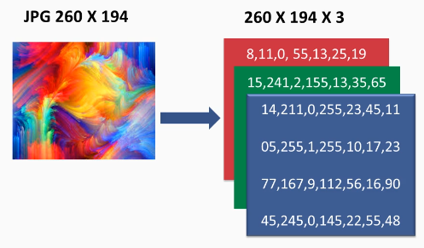
How computer store Images

Slide 27
Intro to Computer Science
How Computers Work
Decimal & Binary numbering systems
How computer store Words (ASCII)
How computer store Images
How computer store Videos
How computer store Audio
How computer understand Mouse
How computer understand Keyboard
How computer understand Speaker & Microphone
How computer understand Monitor & Camera
Technology Tree
Why python

Slide 28
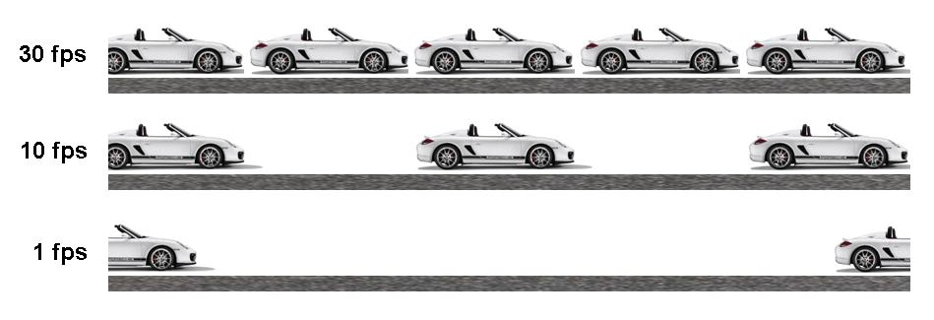
How computer store Videos

Slide 29
Intro to Computer Science
How Computers Work
Decimal & Binary numbering systems
How computer store Words (ASCII)
How computer store Images
How computer store Videos
How computer store Audio
How computer understand Mouse
How computer understand Keyboard
How computer understand Speaker & Microphone
How computer understand Monitor & Camera
Technology Tree
Why python

Slide 30
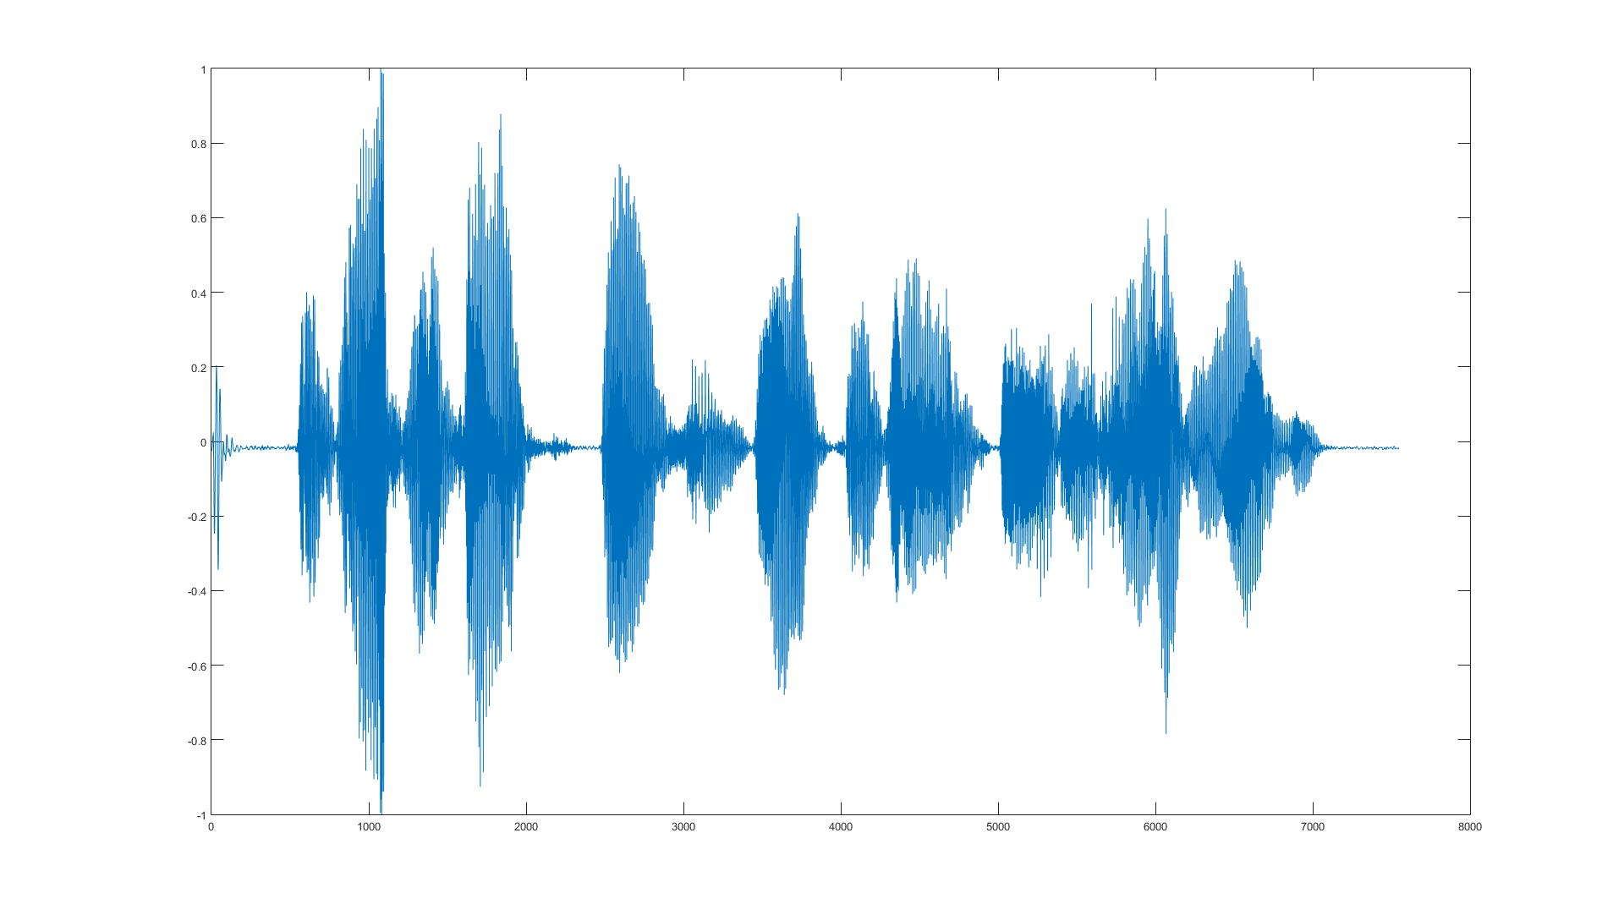
How computer store Audio

Slide 31
Intro to Computer Science
How Computers Work
Decimal & Binary numbering systems
How computer store Words (ASCII)
How computer store Images
How computer store Videos
How computer store Audio
How computer understand Mouse
How computer understand Keyboard
How computer understand Speaker & Microphone
How computer understand Monitor & Camera
Technology Tree
Why python

Slide 32
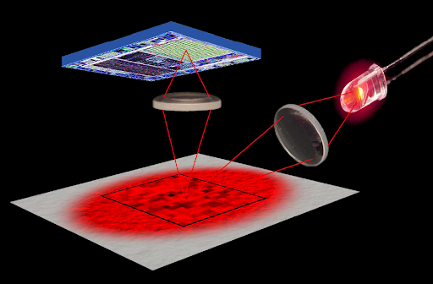
How computer understand Mouse

Slide 33
Intro to Computer Science
How Computers Work
Decimal & Binary numbering systems
How computer store Words (ASCII)
How computer store Images
How computer store Videos
How computer store Audio
How computer understand Mouse
How computer understand Keyboard
How computer understand Speaker & Microphone
How computer understand Monitor & Camera
Technology Tree
Why python

Slide 34
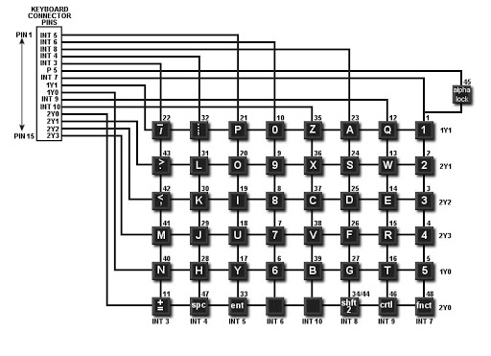
How computer understand Keyboard

Slide 35
Intro to Computer Science
How Computers Work
Decimal & Binary numbering systems
How computer store Words (ASCII)
How computer store Images
How computer store Videos
How computer store Audio
How computer understand Mouse
How computer understand Keyboard
How computer understand Speaker & Microphone
How computer understand Monitor & Camera
Technology Tree
Why python

Slide 36
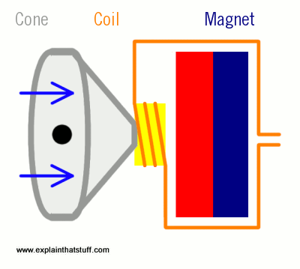
How computer understand Speaker

Slide 37
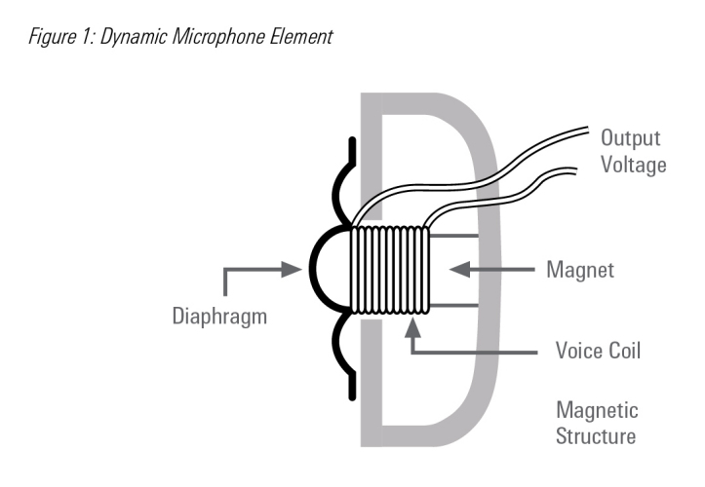
How computer understand Microphone

Slide 38
Intro to Computer Science
How Computers Work
Decimal & Binary numbering systems
How computer store Words (ASCII)
How computer store Images
How computer store Videos
How computer store Audio
How computer understand Mouse
How computer understand Keyboard
How computer understand Speaker & Microphone
How computer understand Monitor & Camera
Technology Tree
Why python

Slide 39
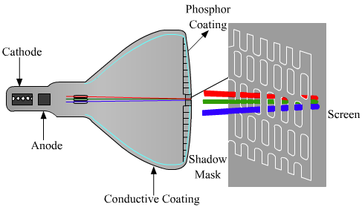
How computer understand Monitor

Slide 40
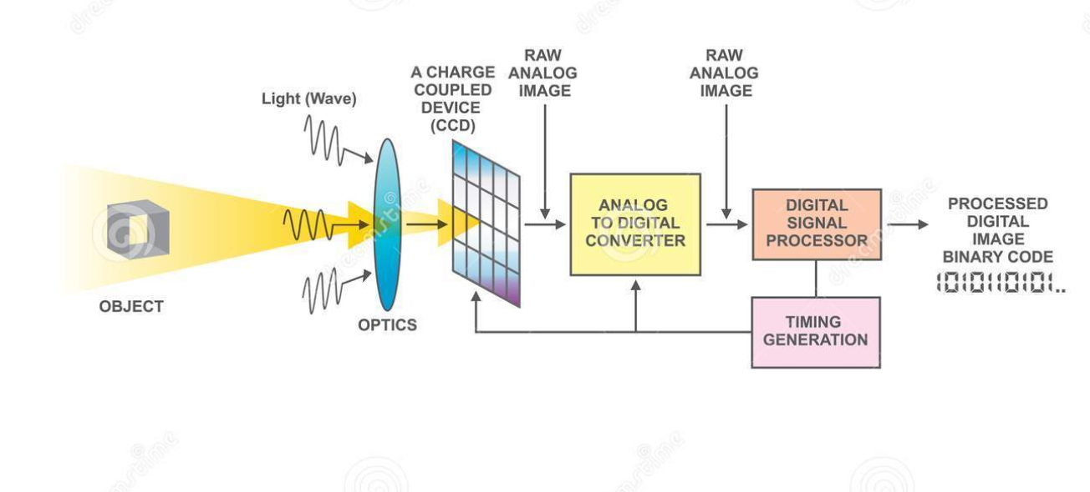
How computer understand Camera

Slide 41
Intro to Computer Science
How Computers Work
Decimal & Binary numbering systems
How computer store Words (ASCII)
How computer store Images
How computer store Videos
How computer store Audio
How computer understand Mouse
How computer understand Keyboard
How computer understand Speaker
How computer understand Microphone
Technology Tree
Why python

Slide 42

Programming ?!
Just writing code for executing some sequential instructions to perform
various tasks.
Computers are FAST but DUMB, they need to know what to do.

Slide 43
Technology Tree
Embedded Systems
Operating Systems
Desktop Applications
Web Applications
Mobile Applications
Database Systems
Networking & Server administration
Internet of Things
Game Development
AR / VR
Compression
Encryption
Security & Ethical Hacking
Machine & Deep Learning
Data Science
Computer Vision
Speech Processing
Natural Language Processing
Autonomous
Blockchain
Big Data
Computer Graphics
Compiler Design
…

Slide 44
Intro to Computer Science
How Computers Work
Decimal & Binary numbering systems
How computer store Words (ASCII)
How computer store Images
How computer store Videos
How computer store Audio
How computer understand Mouse
How computer understand Keyboard
How computer understand Speaker
How computer understand Microphone
Technology Tree
Why python

Slide 45

Why Python ?!
>_ Easy to Learn, Read, Maintain.
>_ Very Big Community so you will find a lot of Libraries to use.

Slide 46
Python 2 vs 3 ?!

Slide 47
Introduction to Python programming Course Outline
Intro to Computer Science
Environment Setup (Anaconda)
Command Line
Conda & pip package managers
Jupyter Notebook
Input & Output
Variables
Data types
Numbers & Math
Boolean & Comparison and Logic
Strings
Lists
Tuples
Sets
Dictionaries
File Handling
If Conditions
For Loops
Built-in functions & Operators (zip, enumerate, range, …)
List Comprehensions
Functions
Lambda Expressions
Map, Filter, Reduce
Variables Scope
Modules & Packages

Slide 48

Awesome Python Distribution. Free and open-source distribution of the Python and R programming languages for scientific computing (data science, machine learning applications) . Anaconda distribution includes data-science packages suitable for Windows, Linux, and macOS. https://www.anaconda.com
ANACONDA

Slide 49

Awesome Code Editor. https://code.visualstudio.com
Visual Studio Code

Slide 50
Introduction to Python programming Course Outline
Intro to Computer Science
Environment Setup (Anaconda)
Command Line
Conda & pip package managers
Jupyter Notebook
Input & Output
Variables
Data types
Numbers & Math
Boolean & Comparison and Logic
Strings
Lists
Tuples
Sets
Dictionaries
File Handling
If Conditions
For Loops
Built-in functions & Operators (zip, enumerate, range, …)
List Comprehensions
Functions
Lambda Expressions
Map, Filter, Reduce
Variables Scope
Modules & Packages

Slide 51
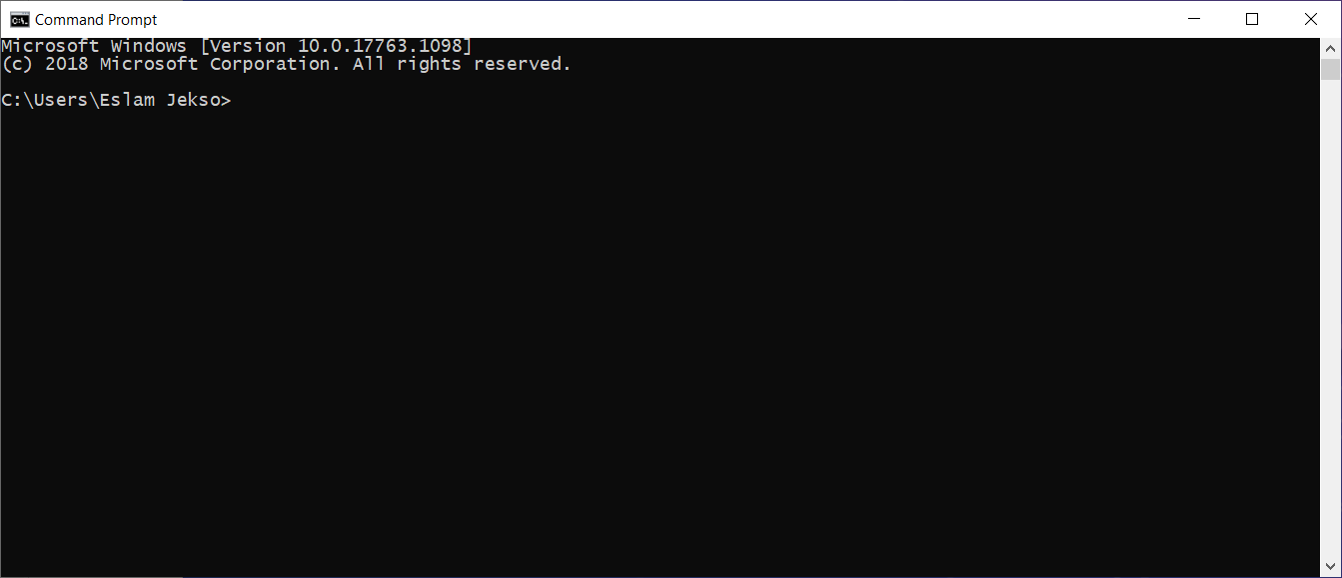
Command Line
>_ cd
>_ dir
>_ copy
>_ del
>_ move
…

Slide 52
Introduction to Python programming Course Outline
Intro to Computer Science
Environment Setup (Anaconda)
Command Line
Conda & pip package managers
Jupyter Notebook
Input & Output
Variables
Data types
Numbers & Math
Boolean & Comparison and Logic
Strings
Lists
Tuples
Sets
Dictionaries
File Handling
If Conditions
For Loops
Built-in functions & Operators (zip, enumerate, range, …)
List Comprehensions
Functions
Lambda Expressions
Map, Filter, Reduce
Variables Scope
Modules & Packages

Slide 53
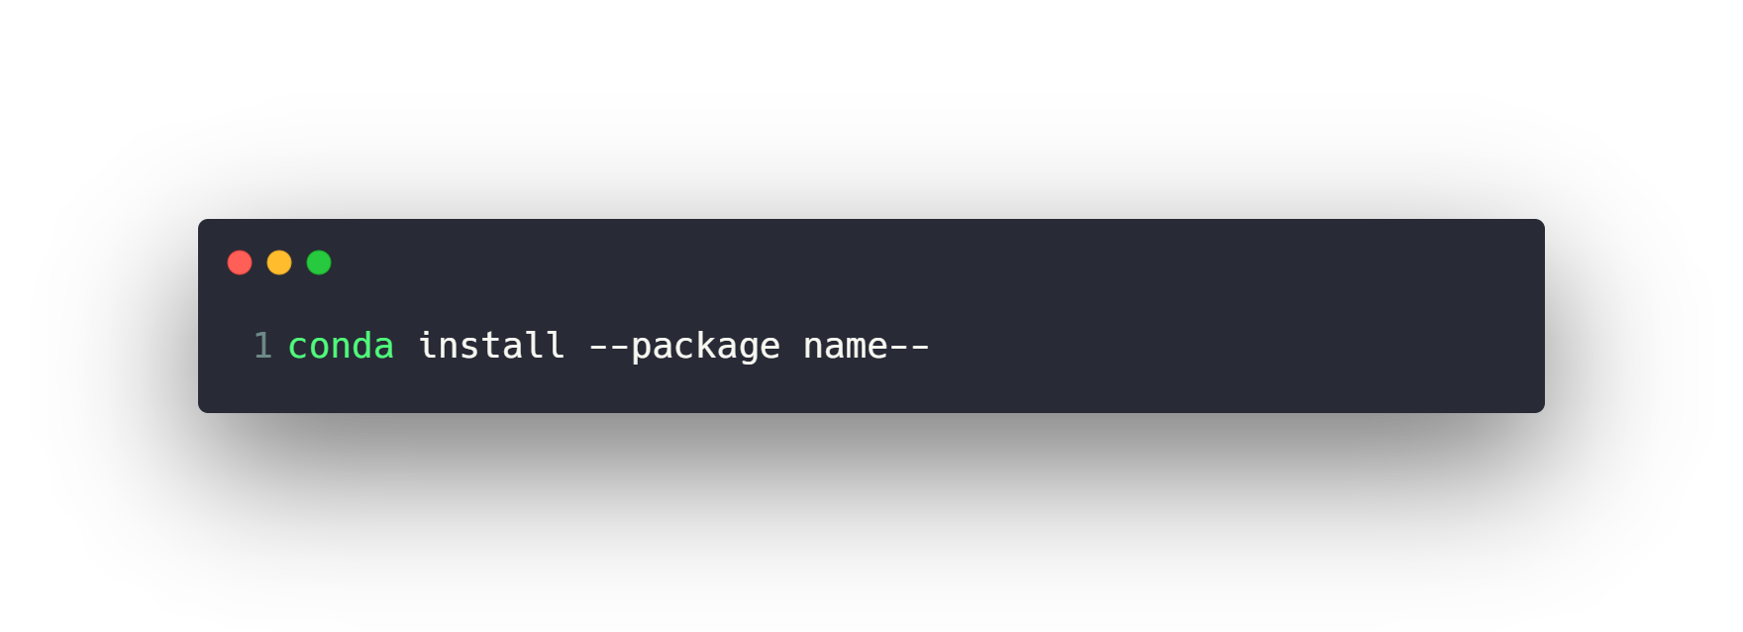
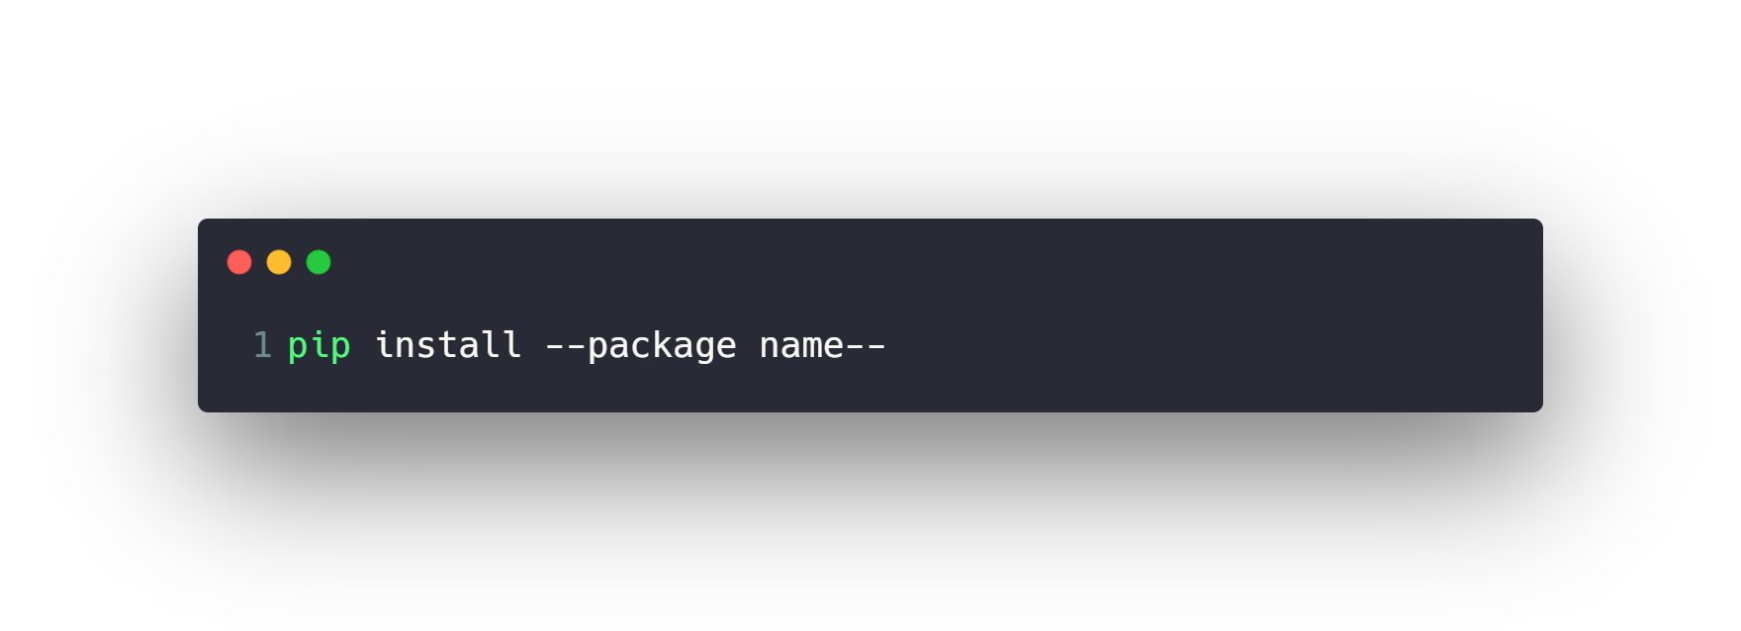
conda & pip package managers
https://anaconda.org/
https://pypi.org/

Slide 54
Introduction to Python programming Course Outline
Intro to Computer Science
Environment Setup (Anaconda)
Command Line
Conda & pip package managers
Jupyter Notebook
Input & Output
Variables
Data types
Numbers & Math
Boolean & Comparison and Logic
Strings
Lists
Tuples
Sets
Dictionaries
File Handling
If Conditions
For Loops
Built-in functions & Operators (zip, enumerate, range, …)
List Comprehensions
Functions
Lambda Expressions
Map, Filter, Reduce
Variables Scope
Modules & Packages

Slide 55
Run Python Script via Command Line
1- Make a .py file
2- Write code & Save it
3- Open cmd
4- >_ python file.py

Slide 56
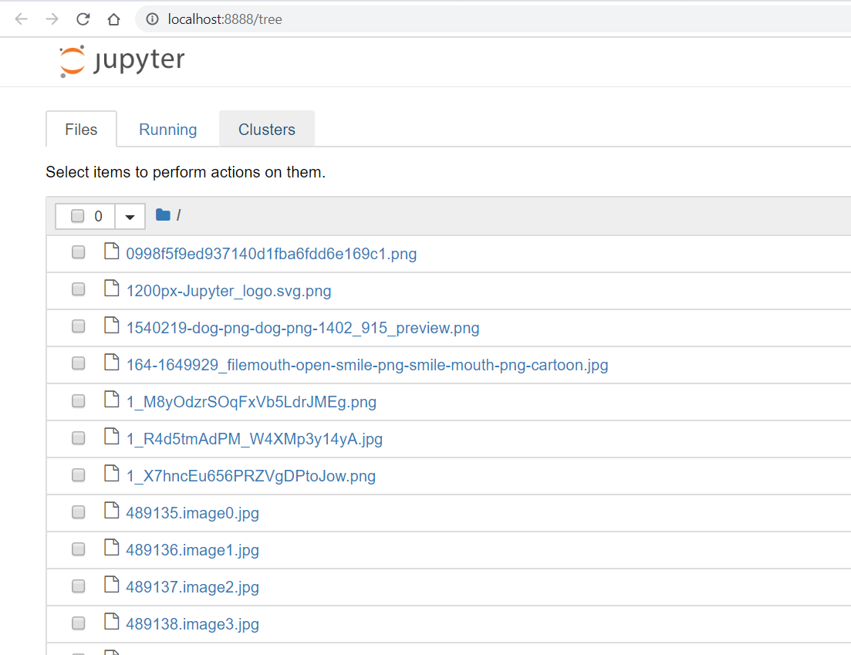
Run Python via Jupyter Notebook
1- Open cmd in a folder
2- >_ jupyter notebook

Slide 57

Jupyter Notebook
Create new .ipynb file
Naming the notebook
Menu buttons (Run, Insert, Delete cells, etc…)
Move Cell up or down
Copy, Paste and Cut Cells
Merge Cells
Code and Markdown Cells
Saving the notebook for checkpoints
Export .py file
Kernel
Use command line in Jupyter using ‘!’ operator

Slide 58
Jupyter Notebook (Shortcuts)
--- > Execute Cell
--- > Execute Cell then go to the next cell
--- > Execute Cell then insert new cell below
--- > Insert Cell Above or Below
--- > Select Cells Above or Below
--- > Copy, Paste and Cut Cells inside Notebook
--- > Copy, Paste and Cut Cells outside Notebook
--- > Delete Cells
--- > Merge Cells
--- > Make Cell type Code or Markdown
--- > Save Notebook
Ctrl + Enter
Shift + Enter
Alt + Enter
A and B
Shift + Up or Down
C and V and X
Ctrl + C or V or X
Double D
Shift + M
Y and M
S
https://www.audiolabs-erlangen.de/resources/MIR/FMP/B/B_Jupyter.html

Slide 59
Questions ?!

Slide 60
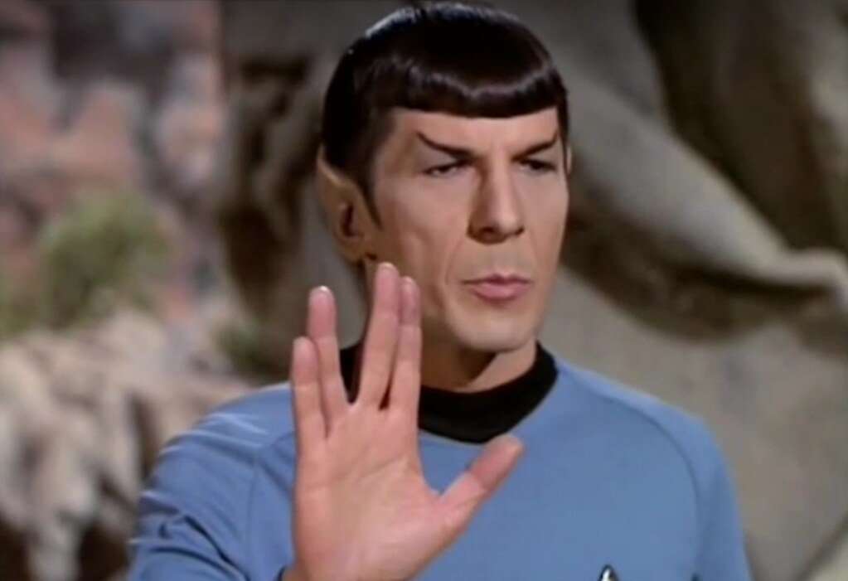
Thanks! >_ Live long and prosper

